Slide 1
Instructors of the Course

Slide 2
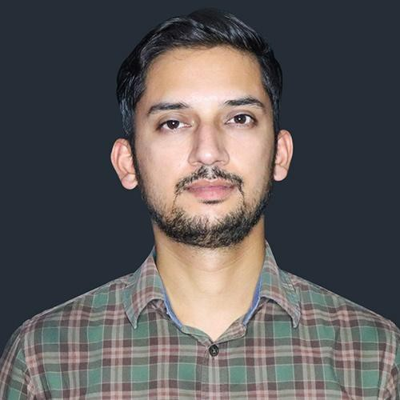
Prateek Joshi
Data Scientist, Analytics Vidhya
NLP Practitioner and Corporate Trainer
Instructor for Fundamentals of Deep Learning

Slide 3
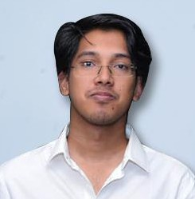
Faizan Shaikh
Data Scientist, Analytics Vidhya
Computer Science Graduate and Deep Learning Practitioner
Areas of interest: Deep Learning, Computer Vision, Audio Processing

Slide 4
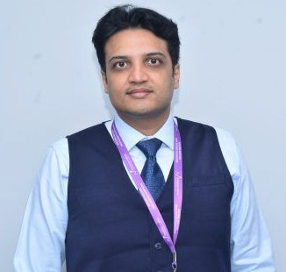
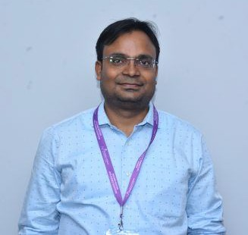
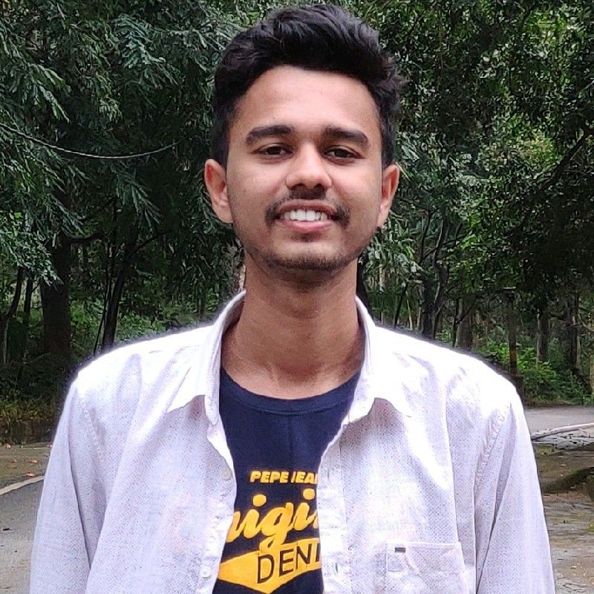
Contributors
Kunal Jain Founder and CEO
Sunil Ray
Chief Content Oﬃcer
Aravind Pai Data Science Trainee

Slide 5

Course Support
Discussion Forum

Slide 6

Course Support
Discussion Forum
Email - training_support@analyticsvidhya.com

Slide 7

Course Support
Discussion Forum
Email - training_support@analyticsvidhya.com
Live Chat Session

Slide 8
Thank You

